Slide 1
Power Query (Data Preparation)
MUKESH KUMAR

Slide 2
AGENDA
1. Loading & Initial Shaping
2. Data Profiling & Data Types
3. Basic Transformations
4. Advanced Transformations
5. Adding & Creating Columns
6. Combining & Merging Data
7. Validating and Preparing Output

Slide 3
What is Power Query
Power Query is the data cleaning and transformation engine inside Power BI.
It’s what makes Power BI so powerful for preparing messy data before you even think about creating visuals.

Slide 4
What is Power Query
Power Query is a no-code/low-code tool used in Power BI (also in Excel) to connect to, transform, and load data into your data model.
It uses a powerful formula language called M (Mashup Language) behind the scenes, but most users rely on its GUI-based interface to clean and shape data without writing code

Slide 5
Key Capabilities of Power Query
Task Category | What You Can Do
Clean Data | Remove errors, nulls, duplicates, trim spaces
Reshape Data | Pivot, unpivot, transpose, group by
Combine Data | Merge (JOIN), Append (UNION), reference queries
Add Logic | Add calculated columns with custom logic
Filter & Sort | Filter rows by values or conditions, sort by column
Change Types | Convert columns to correct data types (text, date)
Split/Extract Data | Split columns by delimiter, extract parts of strings
Structure Data | Create headers, reorder columns, rename fields
Connect to Sources | Excel, CSV, SQL Server, APIs, web, SharePoint, etc.

Slide 6
1. Loading & Initial Shaping
1. Loading Data into Power BI
2. Using the Power Query Editor to Transform Data
3. Managing Rows & Columns
4. Dealing with Unwanted Columns and Null Values

Slide 7
Data Sources in Power BI

Slide 8
1. Loading Data into Power BI 2. Using the Power Query Editor to Transform Data

Slide 9
What Are Data Sources in Power BI?
Data sources are the external systems or files from which Power BI imports or connects to retrieve data.
You can connect to flat files, databases, cloud services, APIs, and even live streaming data.

Slide 10
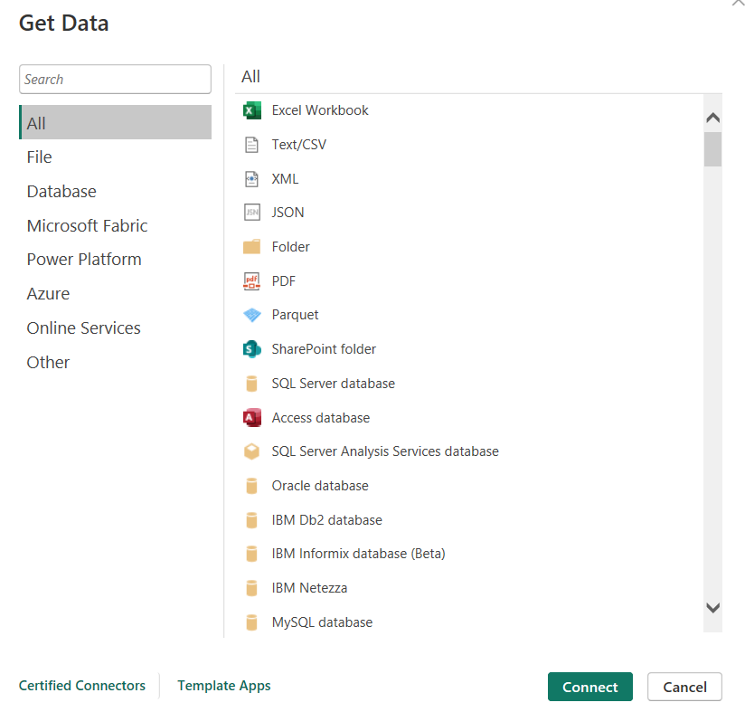
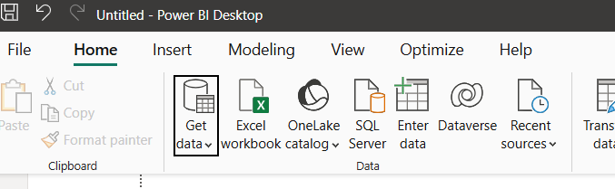

Slide 11
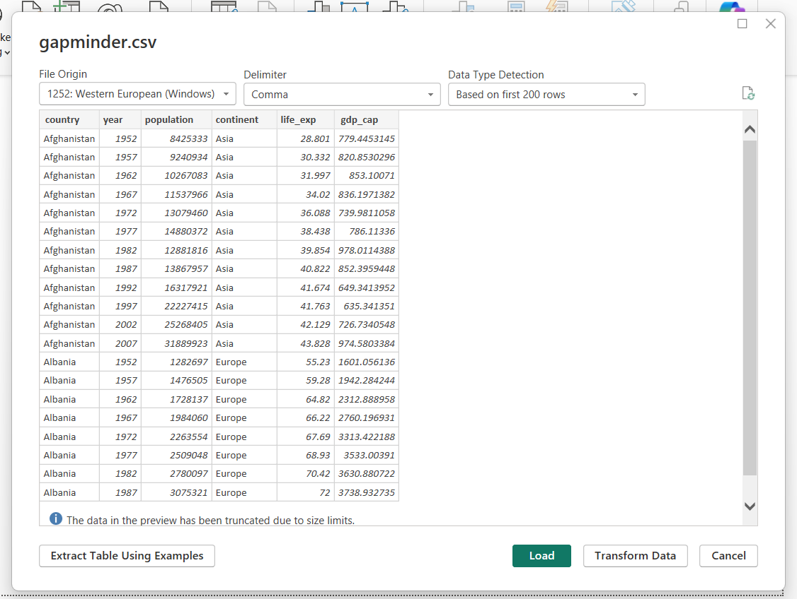
Data Cleaning in Power Query
Editor
Load Data into Power BI

Slide 12

Click Transform Data
Power Query is launched in a separate window where it shows the imported data – ready for data cleaning
Main window will show this message while power query editor is up

Slide 13
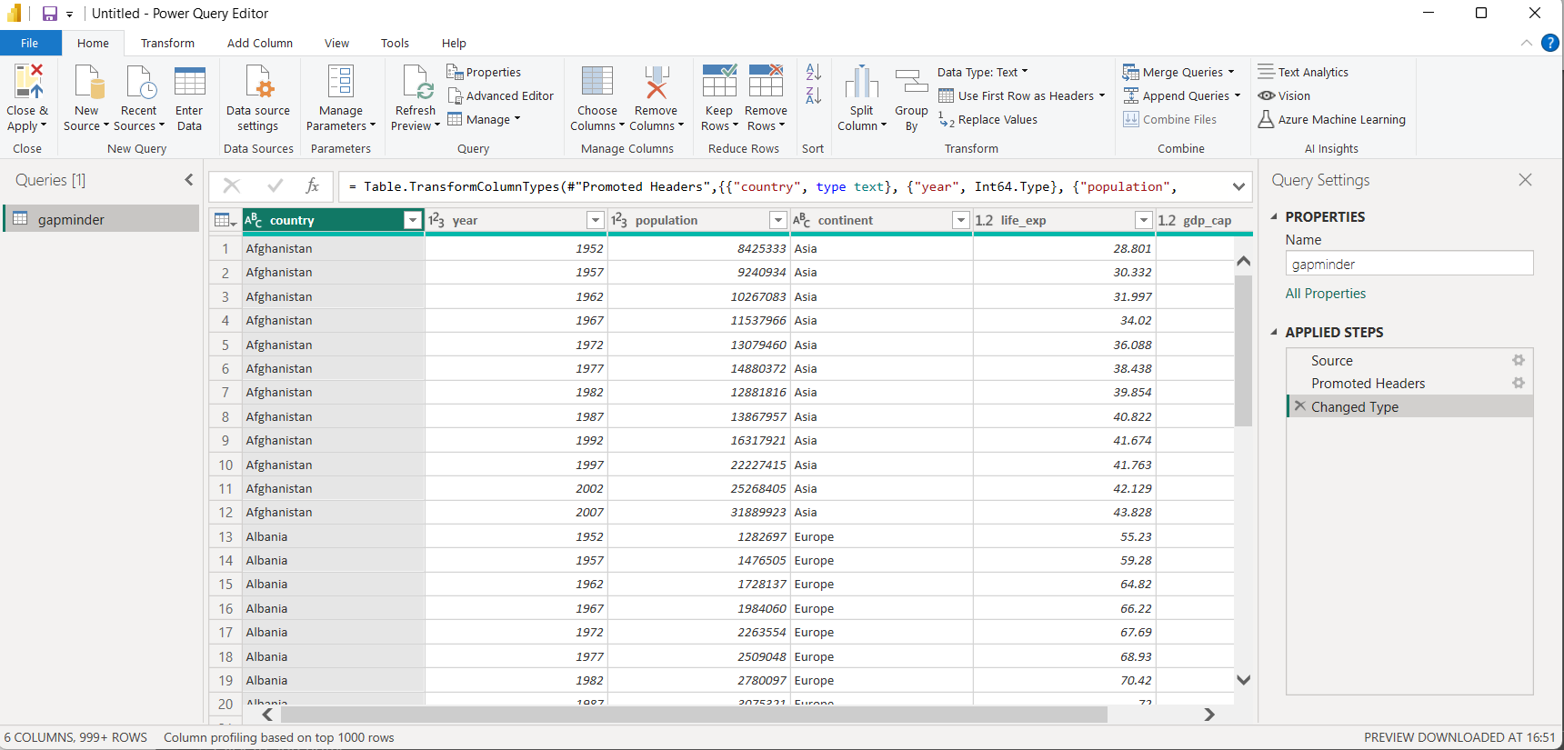
Query Settings pane > shows the transformations applied on the data
It only loads first 1000 rows by default
Undo the transformation using delete button

Slide 14
Query left pane
The left pane shows a list of all the queries (tables or data steps) you've created or loaded into Power BI through Power Query.
It helps you navigate, organize, and manage multiple data sources and transformations easily.

Slide 15
Common Actions in the Left Pane
Action | How It Helps
Select a Query | Click to load its steps in the center editor window
Rename Query | Right-click → Rename for clarity (e.g., Sales_2024)
Duplicate Query | Create a copy of a query with all steps intact
Reference Query | Create a new query that depends on another (useful for modular design)
Delete Query | Remove unused or test queries
Create Folder | Organize multiple queries (Right-click → New Group)
Enable/Disable Load | Right-click → Uncheck “Enable Load” to keep query for logic but not load into model

Slide 16
Query left pane
Let’s say you’re working with a sales Excel file.
In Power Query, you load the sheet → remove nulls → filter dates → rename columns
This entire chain of steps is your query
And even if the underlying Excel file changes later, your query will still work (it re-runs the steps).

Slide 17
Query pane summary
The Left Pane in Power Query Editor is your query manager — it shows all the data tables you're cleaning or transforming, lets you switch between them, and helps organize your entire ETL (Extract, Transform, Load) workflow.

Slide 18
3. Managing Rows & Columns

Slide 19
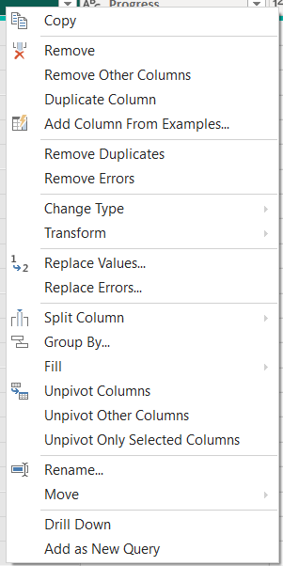
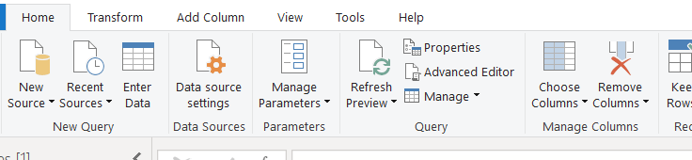
In Power Query Editor, rows and columns can be managed using built-in options on the toolbar or right-click menu.

Slide 20
Managing Columns
Task | How to Do It
Remove columns | Right-click column header → “Remove” or use Home → Remove Columns
Keep specific columns | Select desired columns → Home → Remove Other Columns
Rename columns | Double-click column name or right-click → “Rename”
Reorder columns | Drag and drop, or Transform → Move → To Beginning / To End

Slide 21
Managing Rows
Task | How to Do It
Remove top rows | Home → Remove Rows → Remove Top Rows
Remove blank rows | Home → Remove Rows → Remove Blank Rows
Remove duplicates | Home → Remove Rows → Remove Duplicates
Keep top/bottom N rows | Home → Keep Rows → Keep Top Rows or Bottom Rows
Filter specific values | Click filter icon in column header → Check/uncheck values
Group rows | Transform → Group By (e.g., total sales per category)

Slide 22
4. Dealing with Unwanted Columns and Null Values

Slide 23
Remove Unwanted Columns
Manually select and remove
Select columns → Right-click → Remove
Auto-remove using data profiling
Enable Column Quality / Distribution → Identify low-value columns and remove

Slide 24
Remove or Replace Null Values
Task | How to Do It
Remove rows with nulls | Filter column → Uncheck (null)
Replace nulls with a default value | Right-click column → Replace Values → Enter (null) and a default
Fill nulls with values from above/below | Transform → Fill → Down or Up

Slide 25
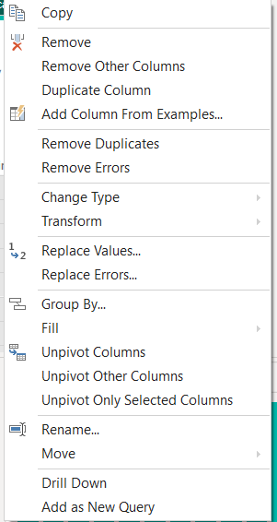
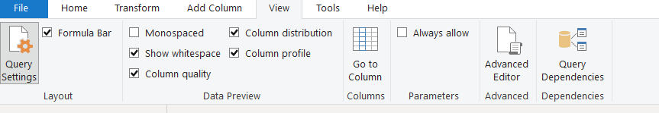

Slide 26
2. Data Profiling & Data Types
5. Data Profiling in Power BI
6. Changing Data Types in Power Query
7. Handling NULLs in Power Query

Slide 27
Data Profiling in Power BI
Definition: A technique to examine the quality, structure, and consistency of data columns.
Why it matters:
Detects errors, nulls, duplicates
Helps prioritize cleaning
Reveals hidden patterns and outliers

Slide 28
Enabling Data Profiling
In Power Query Editor → View Tab:
Column Quality – Valid / Error / Empty %
Column Distribution – Mini histograms
Column Profile – Summary stats (min, max, unique, etc.)
Tip: Always enable before transformations!

Slide 29
Benefits of Data Profiling
Spot data type mismatches
Find NULL-heavy columns
Detect outliers and rare categories
Identify candidate columns for cleanup or removal

Slide 30
6. Changing Data Types in Power Query
Why? Incorrect data types break merges, filters, and calculations.
How?
Click data type icon beside column header
Or: Transform Tab → Data Type → Select appropriate type

Slide 31
Common Type Fixes
Column Value | Change To
"123" (Text) | Whole Number
"Yes" / "No" | Boolean
"12/05/2024" (Text) | Date

Slide 32
Handling NULL Values
Ways to Handle NULLs
Filter them out (uncheck (null) in filter menu)
Replace nulls with “Unknown” / 0 / default
Fill Down / Up from adjacent rows (Transform Tab → Fill)
Remove Rows (if nulls are unacceptable)

Slide 33
Tips & Best Practices
Use profiling to guide your cleaning plan
Fix data types before merges and DAX formulas
Avoid removing too many nulls blindly — check context

Slide 34
3. Basic Transformations
8. Dealing with Text Tools
9. Transform Text Columns
10. Dealing with Numerical Tools
11. Transform Number Columns
12. Dealing with Date and Time
13. Transform Date Columns
14. General Column Transformations
15. Column Formats in Power BI

Slide 35
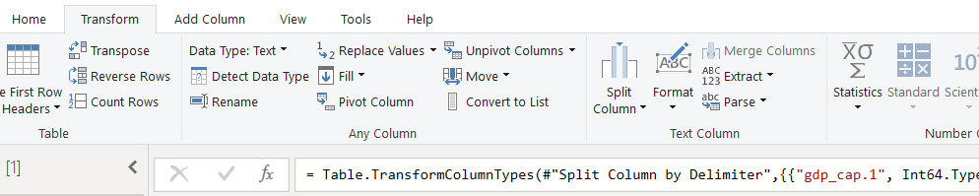
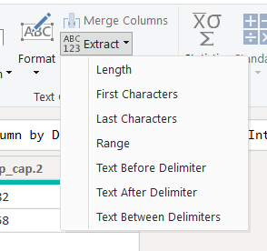
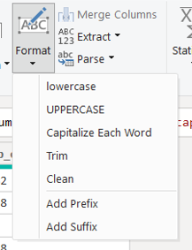
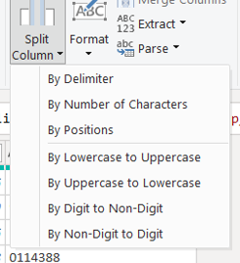
Dealing with Text Tools
Power BI provides rich tools for cleaning and reshaping text data.

Slide 36
Common Operations:
Remove leading/trailing whitespaces → Transform → Format → Trim
Change case → Upper, Lower, Capitalize Each Word
Replace values → Transform → Replace Values
Extract substrings (e.g., first 5 characters) → Transform → Extract → First Characters
Split column by delimiter → Split Column → By Delimiter (e.g., “,” or “-”)

Slide 37
Transform Text Columns
Text transformation tools are great for standardizing formats.
Key Features:
Format → Trim, Clean, Uppercase
Extract → First N characters, Range, Text Before/After Delimiter
Parse → Split column (e.g., split full name into first/last)
Detect patterns and fill using Column from Examples

Slide 38
Dealing with Numerical Tools
Numeric Fixes:
Convert text numbers to numeric types
Remove unwanted decimal places
Replace nulls with 0
Remove outliers or errors
Where in Power Query:
Transform Tab → Data Type: Whole/Decimal/Fixed
Home Tab → Replace Values / Remove Errors

Slide 39
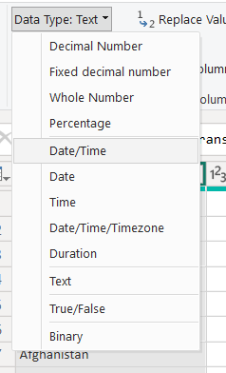
Dealing with Numerical Tools

Slide 40
Transform Number Columns
Operations:
Basic math: Add/Subtract/Multiply/Divide
Rounding: Up, Down, To Nearest
Statistical: Average, Min, Max, Std Dev
Scientific: Power, Logarithm
Where in Power Query:
Transform Tab → Standard / Rounding / Statistics / Scientific

Slide 41
Dealing with Date and Time
Use Cases:
Convert text to date
Fix invalid date values
Add missing dates manually
Standardize format
Where in Power Query:
Transform Tab → Data Type: Date / DateTime
Transform Tab → Format (in Power BI Data View)

Slide 42
Transform Date Columns
Operations:
Extract: Year, Month, Day, Week, Quarter
Calculate Age
Start/End of: Month, Quarter, Year
Convert to day name / month name
Where in Power Query:
Transform Tab → Date → Extract / Start of / End of / Day / Week / Month / Year

Slide 43
4. Advanced Transformations
16. Power BI Fill Transformation
17. Fill By, Group By
18. Remove & Keep Rows

Slide 44
Fill Transformation (Up/Down)
Purpose: Fill null values in a column by copying non-null values upward or downward.
Use Cases:
Hierarchical data where parent rows are blank (e.g., region only in first row)
Repeating headers or metadata that need propagation
Where in Power Query:
Transform Tab → Fill → Down / Up

Slide 45
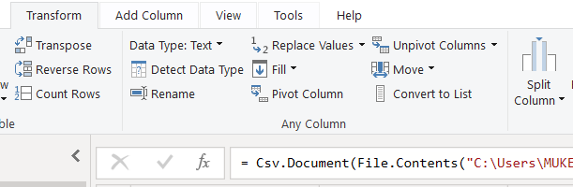
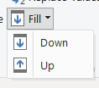
Fill Transformation (Up/Down)

Slide 46
Group By Transformation
Purpose: Summarize data by grouping on one or more columns and applying aggregate functions.
Use Cases:
Count orders per customer
Total sales per region
Get latest date for each product
Where in Power Query:
Transform Tab → Group By
Example:
Group by CustomerID, Aggregate OrderTotal using Sum
NOTE: use sales dataset for this exercise

Slide 47
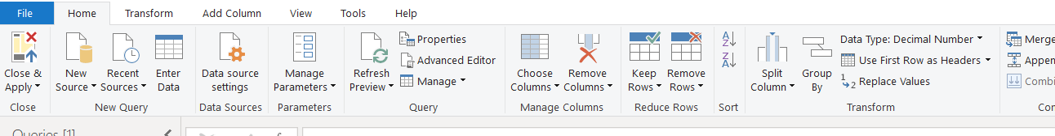
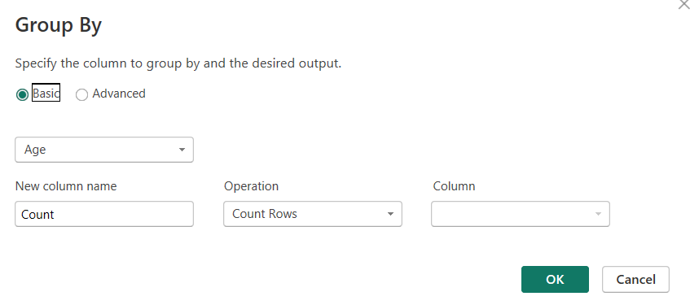

Slide 48
Fill By, Group By
Fill By
Use Fill Down / Fill Up to handle missing category values.
Group By
Apply aggregations per group like Sum, Max, Count, etc.
Where in Power Query:
Transform Tab → Fill / Group By / Transpose
Caution: Transpose is destructive — use only if structure demands it (like transposed Excel files).

Slide 49
Remove & Keep Rows
Purpose:
Filter out unwanted rows or keep only relevant data.
Options:
Remove Top/Bottom N rows
Remove Duplicates
Remove Blank or Error rows
Keep Range or Matching Rows
Where in Power Query:
Home Tab → Remove Rows / Keep Rows

Slide 50
5. Adding & Creating Columns
Add Columns from Text
Add Columns from Number
Add Columns from Date & Time
Add Columns – From Example
Adding New Columns with Fill from Example
Adding Conditional Columns

Slide 51
These transformations allow you to create new columns based on logic, patterns, or existing data. Found in the "Add Column" tab in Power Query Editor.

Slide 52
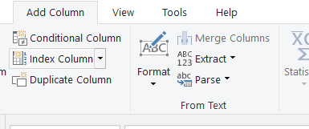
Add Columns from Text
Use: Extract values from text (e.g., first name from full name)
Examples:
Extract substring, split text by delimiter, change case
Where: Add Column → Extract / Format / Parse → From Text

Slide 53
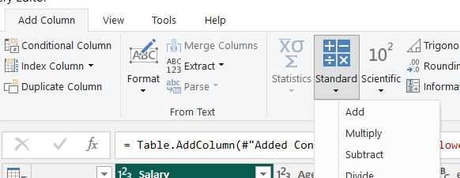
Add Columns from Number
Use: Apply math operations (e.g., rounding, logarithm)
Examples:
Round sales to 2 decimals, get absolute value, apply % increase
Where: Add Column → From Number

Slide 54
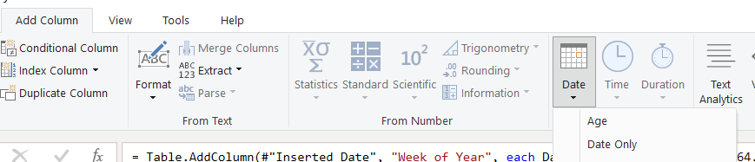
Add Columns from Date & Time
Use: Create new time-based columns
Examples:
Extract year from date, day of week, time only, age from DOB
Where: Add Column → From Date / Time / DateTime

Slide 55
Add Column – From Example
Use: Let Power BI learn a pattern from your input
Examples:
Enter how you want a column to look → Power BI generates logic
E.g., Extract domain from email or initials from name
Where: Add Column → Column From Examples → From All Columns / Selection

Slide 56
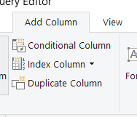
Adding Conditional Columns
Use: Create IF...ELSE logic without M code
Examples:
If Profit > 0 then "Profit" else "Loss"
Bucket sales into "Low", "Medium", "High"
Where:
Add Column → Conditional Column

Slide 57
Tip for All Columns
Once a column is added, you can always:
Rename it
Change its data type
Apply further transforms

Slide 58
Merge & Append Queries

Slide 59
Merge Queries
Merge - Creates new column
Append- creates new rows

Slide 60
Merge Queries
Use Case:
Combine columns from two queries based on a matching field (similar to SQL JOIN)
Why it's useful:
Add customer info to sales data using CustomerID
Merge product details with transaction data
Types of Joins Available:
Left Join (default), Right Join, Full Outer Join, Inner Join, Anti Joins (Left/Right Only)
Where to find it:
Home Tab → Merge Queries (or "Merge Queries as New" to create a new table)

Slide 61
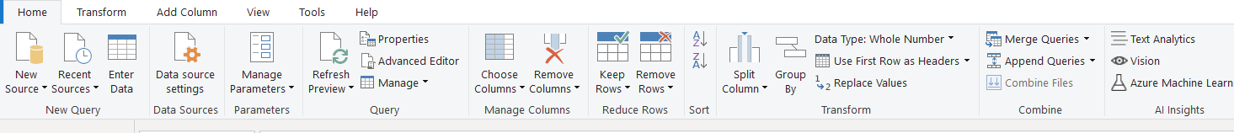
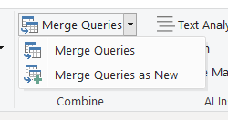

Slide 62
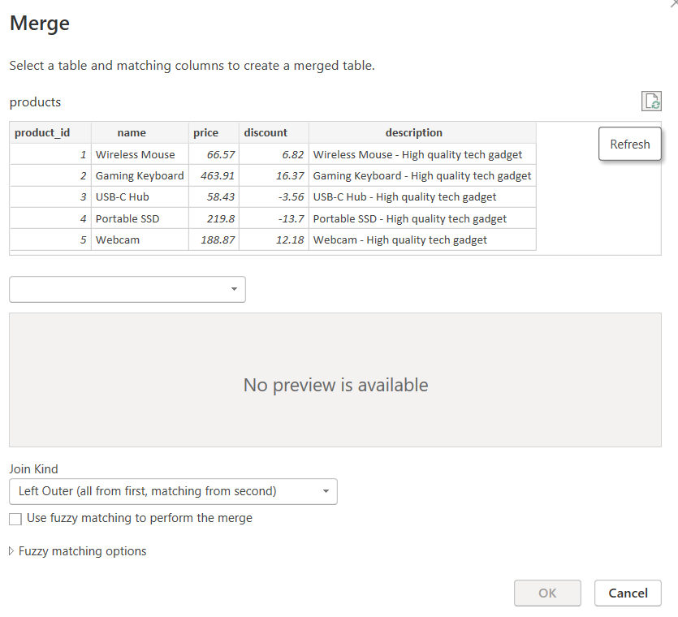

Slide 63
Append Queries
Use Case:
Stack data vertically — combine rows from two or more tables with the same structure (like SQL UNION)
Why it's useful:
Combine monthly or yearly data files
Combine survey results from different regions
Append Modes:
Append as a new query
Append directly to existing query
Where to find it:
Home Tab → Append Queries (or "Append Queries as New")

Slide 64
Merge Vs Append
Feature | Merge Queries | Append Queries
Action | Join columns (side-by-side) | Combine rows (top-to-bottom)
Use When | Linking related data tables | Stacking same-structured datasets
Example | Add Customer Name to Orders | Combine January and February sales

